Slide 1
Section 1.7
Problem Solving;
Interest, Mixture, Uniform Motion, Constant Rate Job Applications
Copyright © 2012 Pearson Education, Inc. Publishing as Prentice Hall.

Slide 2
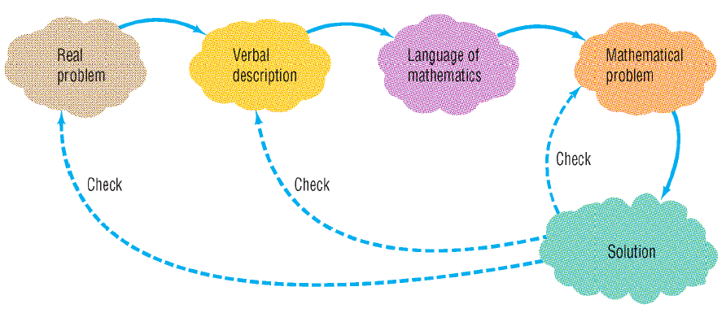
Copyright © 2012 Pearson Education, Inc. Publishing as Prentice Hall.

Slide 3
Copyright © 2012 Pearson Education, Inc. Publishing as Prentice Hall.

Slide 4

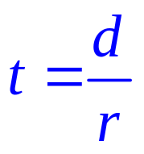



For uniform motion, the time required for an object to travel equals the distance traveled divided by the speed of the object.
If t is time, r is speed and d is distance, then
The length of a rectangle is four times its width.
Five times a number, decreased by 3
The product of 3 and a number increased by 5
Copyright © 2012 Pearson Education, Inc. Publishing as Prentice Hall.

Slide 5
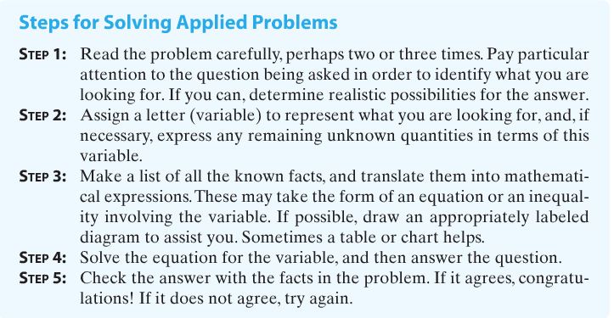
Copyright © 2012 Pearson Education, Inc. Publishing as Prentice Hall.

Slide 6

Copyright © 2012 Pearson Education, Inc. Publishing as Prentice Hall.

Slide 7
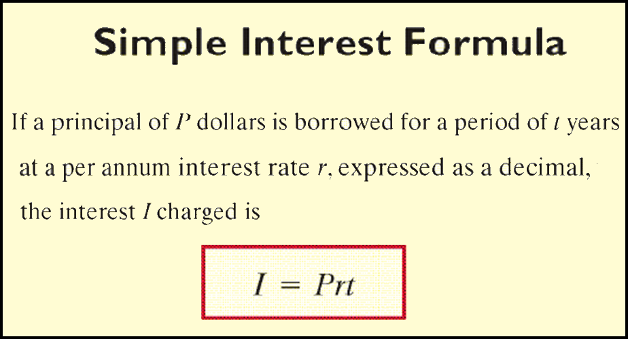
Copyright © 2012 Pearson Education, Inc. Publishing as Prentice Hall.

Slide 8

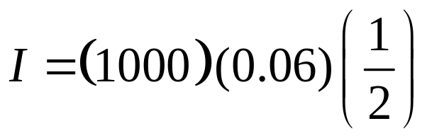

Suppose you borrow $1000 for 6 months at the simple interest rate of 6% per annum. What is the interest you will be charged on this loan? If you pay the loan back at the end of 6 months, what is the amount you must pay?
After 6 months you would owe the amount you borrowed plus the interest: $1000 + $30.00 = $1030
Copyright © 2012 Pearson Education, Inc. Publishing as Prentice Hall.

Slide 9

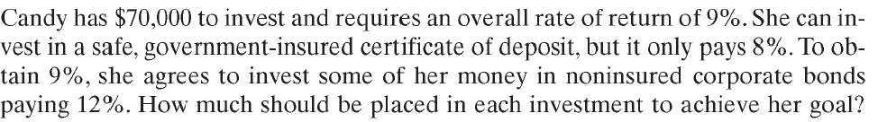
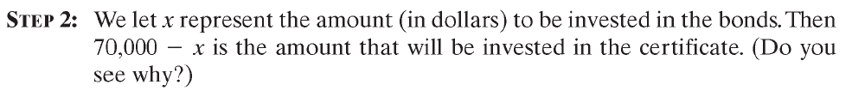
Copyright © 2012 Pearson Education, Inc. Publishing as Prentice Hall.

Slide 10
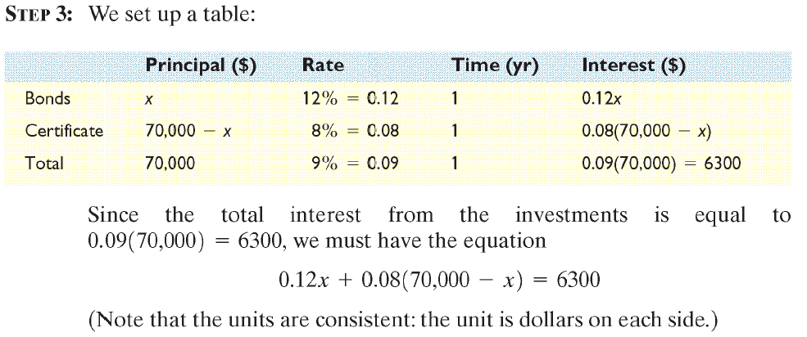
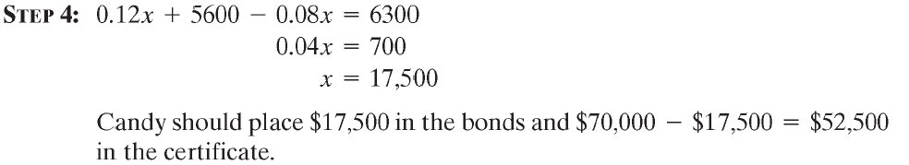
Copyright © 2012 Pearson Education, Inc. Publishing as Prentice Hall.

Slide 11
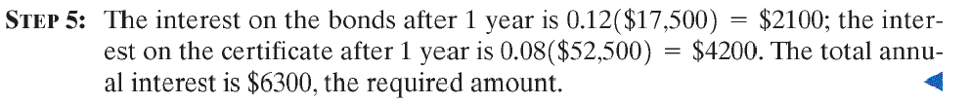
Copyright © 2012 Pearson Education, Inc. Publishing as Prentice Hall.

Slide 12

Copyright © 2012 Pearson Education, Inc. Publishing as Prentice Hall.

Slide 13

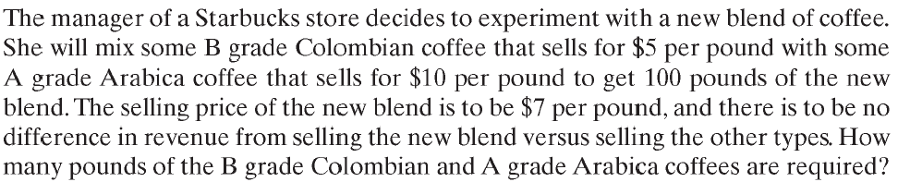
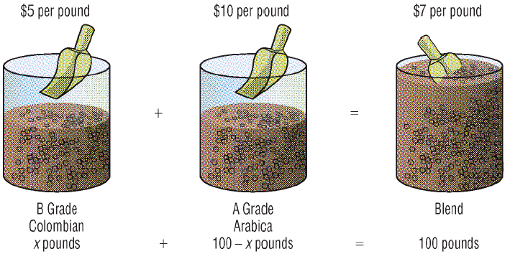
Copyright © 2012 Pearson Education, Inc. Publishing as Prentice Hall.

Slide 14
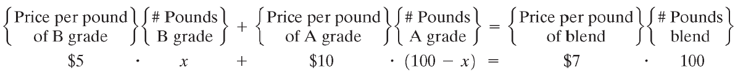
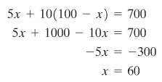
The manager should blend 60 pounds of B grade Colombian coffee with
100 – 60 = 40 pounds of A grade Arabica coffee.
Copyright © 2012 Pearson Education, Inc. Publishing as Prentice Hall.

Slide 15

Copyright © 2012 Pearson Education, Inc. Publishing as Prentice Hall.

Slide 16
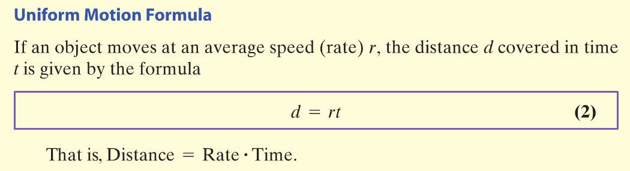
Copyright © 2012 Pearson Education, Inc. Publishing as Prentice Hall.

Slide 17

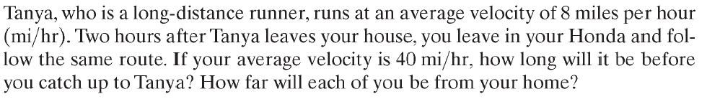
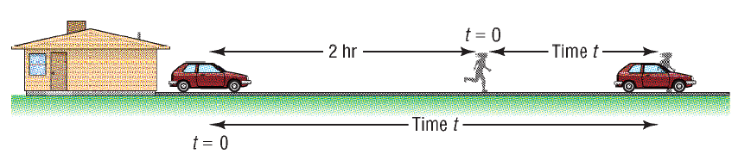
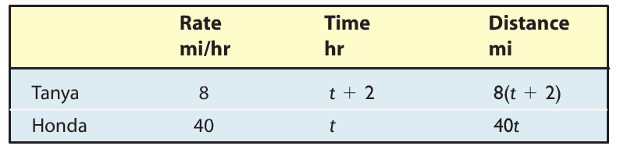
Copyright © 2012 Pearson Education, Inc. Publishing as Prentice Hall.

Slide 18
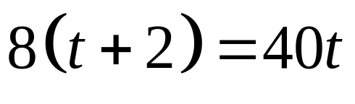
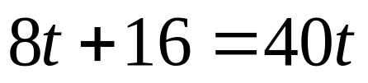
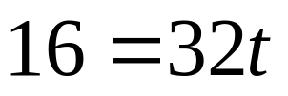
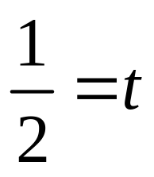
Copyright © 2012 Pearson Education, Inc. Publishing as Prentice Hall.

Slide 19
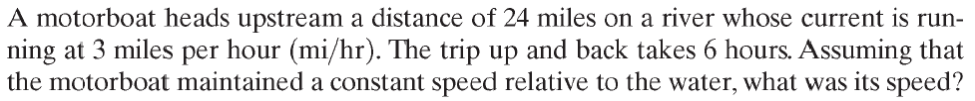
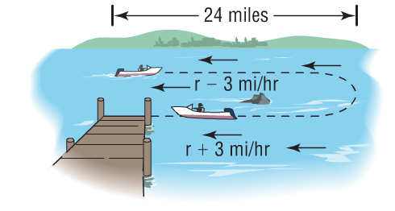

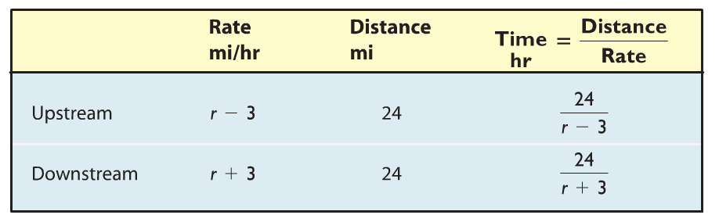
Copyright © 2012 Pearson Education, Inc. Publishing as Prentice Hall.

Slide 20



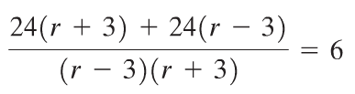




Copyright © 2012 Pearson Education, Inc. Publishing as Prentice Hall.

Slide 21

Copyright © 2012 Pearson Education, Inc. Publishing as Prentice Hall.

Slide 22
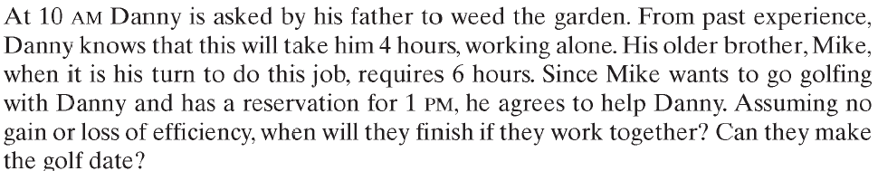
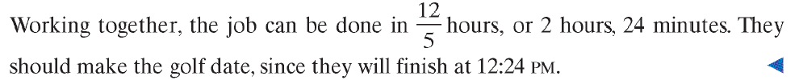

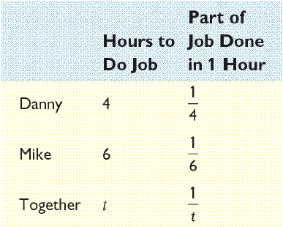





Copyright © 2012 Pearson Education, Inc. Publishing as Prentice Hall.

